Slide 1
HiWi Reports
| Haochen Zhang | 11.05.2026

Slide 2
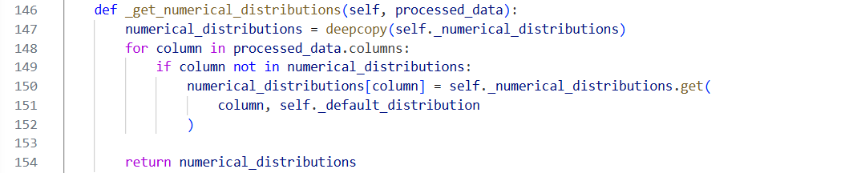
Date and timestamp do not match after anonymization
Row 146 _get_numerical_distributions(self, processed_data): Column-wise distribution choice. it decides which univariate distribution each column will use when the Gaussian copula model is fitted.
Date and timestamp columns as separate variables during preprocessing and synthesis.
| Haochen Zhang | 11.05.2026

Slide 3
Filtered Data has higher overall score
Data comparison
  Original Data:
    Number of rows: 2871
    Location: Logistic Centre, Atlantis waterpark
    Energy source: Electricity, District heating, Water supply (network), Water supply(well), Water supply
  Filtered Data:
    Number of rows: 862
    Location: Logistic Centre
    Energy source: Electricity
| Haochen Zhang | 11.05.2026

Slide 4
Filtered Data has higher overall score
Type to filter
  Location: Logistic Centre
  Energy Source: Electricity
Overall score
  Without filter
CTGAN quality score: 0.7874419279907086
Gaussian quality score: 0.7216124661246612
  With filter
    CTGAN quality score:0.8675412237859502
    Gaussian quality score: 0.8298054267298535
| Haochen Zhang | 11.05.2026

Slide 5
Compare 3 columns
Related columns in tables(date and timestamps are generated independently)
Sdtype (faker lib, replace items list(how to generate)) not exist in sdtypes (LLM)
| Haochen Zhang | 11.05.2026

Slide 6
SMX Table
 | Actor_type | City | Country | GPS | Project | RBAC | Service | User_name | SMXtimestamp
Me | 0 | 0 | 0 | 1 | 0 | 0 | 0 | 1 | 1
PII Scan | 0 | 0 | 1 – 0.85 | 1 – 0.01 | 1 – 0.30 | 0 | 0 | 0 | 1 – 0.85
LLM | 0 – 0.20 | 1 – 0.80 | 1 – 0.70 | 1 – 0.90 | 0 - 0.25 | 0 - 0.25 | 0 – 0.20 | 1 – 1.00 | 1 – 0.10
0 – not necessary
1 – must
Confidence score
City, country, GPS
| Haochen Zhang | 11.05.2026

Slide 7
SMX Table
PII | Predicted P | Predicted N
Actual P | 2 | 1
Actual N | 2 | 4
Accuracy = (TP+TN) / 9 = 6 / 9 =0.667
Precision = TP / (TP+FP) = 2 / 4 = 0.5
Recall = TP / (TP+FN) = 2 / 3 = 0.667
F1 = 2PR / (P + R) = 0.571

Slide 8
SMX Table
LLM | Predicted P | Predicted N
Actual P | 3 | 0
Actual N | 2 | 4
Accuracy = (TP+TN) / 9 = 7 / 9 = 0.778
Precision = TP / (TP+FP) = 3 / 5 = 0.6
Recall = TP / (TP+FN) = 3 / 3 = 1
F1 = 2PR / (P + R) = 0.75

Slide 9
Sampledata
 | Date | Timestamp | Location | Energy Source | Measure | Unit of Measure | Interval | Value
Me | 1 | 1 | 1 | 1 | 0 | 0 | 0 | 0
PII Scan | 1 – 0.60, 0.85 | 1 | 0 | 0 | 0 | 1 – 0.30 | 0 | 1 – 0,40
LLM | 1 – 0.93 | 1 – 0.95 | 1 – 0.92 | 1 – 0.70 | 1 – 0.78 | 0 – 0.35 | 0 – 0.40 | 0 – 0.50
0 – not necessary
1 – must
Confidence score
| Haochen Zhang | 11.05.2026

Slide 10
Sampledata
PII | Predicted P | Predicted N
Actual P | 2 | 2
Actual N | 2 | 2
Accuracy = (TP+TN) / 8 = 4 / 8 =0.5
Precision = TP / (TP+FP) = 2 / 4 = 0.5
Recall = TP / (TP+FN) = 2 / 4 = 0.5
F1 = 2PR / (P + R) = 0.5

Slide 11
Sampledata
LLM | Predicted P | Predicted N
Actual P | 4 | 0
Actual N | 1 | 3
Accuracy = (TP+TN) / 8 = 7 / 8 = 0.875
Precision = TP / (TP+FP) = 4 / 5 = 0.8
Recall = TP / (TP+FN) = 4 / 4 = 1
F1 = 2PR / (P + R) = 0.89

Slide 12
Weather data
 | feeder | timestamp_UTC | timestamp_CET_CEST | direct_radiation_W/m2 | diffuse_radiation_W/m2 | air_temperature_C | precipitation_kg/m2 | snow_height_m | humidity_kg/kg | max_wind_gust_m/s | meridional_wind_m/s | zonal_wind_m/s
Me | 1 | 1 | 1 | 0 | 0 | 0 | 0 | 0 | 0 | 0 | 0 | 0
PII Scan | 0 | 1 – 0.85 | 1 | 1 | 1 | 1 | 1 | 1 | 1 | 1 | 1 | 1
LLM | 1 – 0.95 | 0 – 0.35 | 0 – 0.35 | 0 – 0.10 | 0 – 0.10 | 0 – 0.10 | 0 – 0.10 | 0 – 0.10 | 0 – 0.10 | 0 – 0.10 | 0 – 0.10 | 0 – 0.10
0 – not necessary
1 – must
Confidence score
| Haochen Zhang | 11.05.2026

Slide 13
Weather data
PII | Predicted P | Predicted N
Actual P | 2 | 1
Actual N | 9 | 0
Accuracy = (TP+TN) / 12 = 2 / 12 = 0.167
Precision = TP / (TP+FP) = 2 / 11 = 0.182
Recall = TP / (TP+FN) = 2 / 3 = 0.667
F1 = 2PR / (P + R) = 0.286

Slide 14
Weather data
LLM | Predicted P | Predicted N
Actual P | 1 | 2
Actual N | 0 | 9
Accuracy = (TP+TN) / 12 = 10 / 12 = 0.833
Precision = TP / (TP+FP) = 1 / 1 = 1
Recall = TP / (TP+FN) = 1 / 2 = 0.5
F1 = 2PR / (P + R) = 0.833

Slide 15
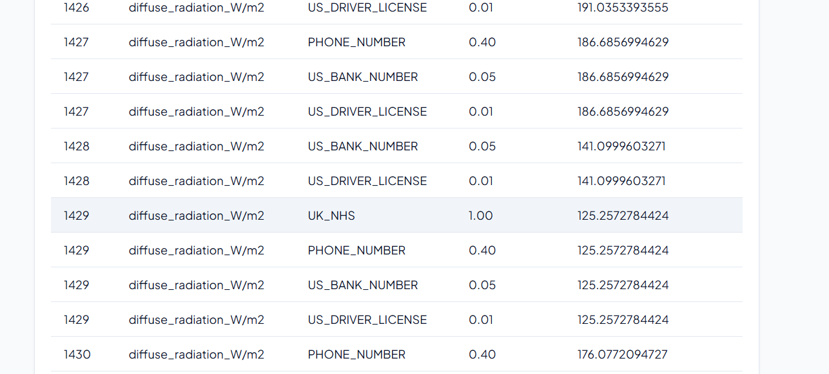
Weather Data
| Haochen Zhang | 11.05.2026

Slide 16
Weather data given PD
 | feeder | timestamp_UTC | timestamp_CET_CEST | direct_radiation_W/m2 | diffuse_radiation_W/m2 | air_temperature_C | precipitation_kg/m2 | snow_height_m | humidity_kg/kg | max_wind_gust_m/s | meridional_wind_m/s | zonal_wind_m/s
Me | 1 | 1 | 1 | 0 | 0 | 0 | 0 | 0 | 0 | 0 | 0 | 0
LLM | 1 – 0.70 | 0 – 0.20 | 0 – 0.20 | 0 – 0.00 | 0 – 0.00 | 0 – 0.00 | 0 – 0.00 | 0 – 0.00 | 0 – 0.00 | 0 – 0.00 | 0 – 0.00 | 0 – 0.00
0 – not necessary
1 – must
Confidence score
1. **DPV‑Definition von personenbezogenen Daten**
DPV unterscheidet klar zwischen *personenbezogenen* und *nicht‑personenbezogenen* Daten.
Daten gelten als personenbezogen, wenn sie einer *identifizierten* oder *identifizierbaren* natürlichen Person zugeordnet werden können.
2. **Identifier‑Kategorie**
In DPV ist ein „Identifier“ (z. B. ID‑Nummer, Gerätename) als personenbezogen klassifiziert, wenn der Identifier in Verbindung mit einer Person steht.
Der *feeder* ist ein möglicher eindeutiger Bezeichner für eine Messstation; wenn diese Station in privatem oder firmeneigenem Besitz ist,
könnte der Identifier zur Identifikation der jeweiligen Person oder des Unternehmens verwendet werden.
3. **Temporal‑ und Location‑Daten**
Zeitstempel (und in Kombination mit Standortdaten) können zur Re‑Identifikation herangezogen werden, wenn genügend Kontext vorhanden ist.
In Ihrem Datensatz gibt es jedoch keine direkten Standortangaben, sodass das Risiko klein ist. Deshalb wird ein niedriger Confidence‑Score gesetzt.
4. **Technische Messdaten**
Alle übrigen Spalten liefern reine physikalische Messwerte (Temperatur, Strahlung, Windgeschwindigkeit, etc.)
und stellen keine direkte oder indirekte Information über eine Person dar. DPV klassifiziert diese als *technische Messdaten* und erfordert keine Anonymisierung.
| Haochen Zhang | 11.05.2026

Slide 17
Weather data given PD
LLM | Predicted P | Predicted N
Actual P | 1 | 2
Actual N | 0 | 9
Accuracy = (TP+TN) / 12 = 10 / 12 = 0.833
Precision = TP / (TP+FP) = 1 / 1 = 1
Recall = TP / (TP+FN) = 1 / 3 = 0.333
F1 = 2PR / (P + R) = 0.5

Slide 18
Weather data given LOC
 | feeder | timestamp_UTC | timestamp_CET_CEST | direct_radiation_W/m2 | diffuse_radiation_W/m2 | air_temperature_C | precipitation_kg/m2 | snow_height_m | humidity_kg/kg | max_wind_gust_m/s | meridional_wind_m/s | zonal_wind_m/s
Me | 1 | 1 | 1 | 0 | 0 | 0 | 0 | 0 | 0 | 0 | 0 | 0
LLM | 1 – 0.70 | 0 – 0.30 | 0 – 0.30 | 0 – 0.00 | 0 – 0.00 | 0 – 0.00 | 0 – 0.00 | 0 – 0.00 | 0 – 0.00 | 0 – 0.00 | 0 – 0.00 | 0 – 0.00
0 – not necessary
1 – must
Confidence score
- **Feeder**: 70 % Wahrscheinlichkeit, dass diese Spalte ortsbezogene bzw.
personenbezogene Daten enthält. **Empfehlung**:
pseudonymisieren (z. B. Hash) oder entfernen, falls rechtlich nötig.
- **Timestamp‑Spalten**: 30 % Wahrscheinlichkeit, dass sie in Kombination mit Standortdaten personenbezogen werden könnten.
**Empfehlung**: prüfen, ob sie wirklich nötig sind; wenn ja, ggf. aggregieren (z. B. auf Stunden‑ oder Tagesbasis).
- **Alle anderen Spalten**: 0 % Wahrscheinlichkeit, dass sie als ortsbezogene Daten gelten.
Kein Anonymisierungsbedarf gemäß DPV‑Location‑Abstrakt.
> **Hinweis:** Der DPV‑Abstrakt konzentriert sich auf das Konzept „Location“ – geografische oder räumliche Information.
Da die Tabelle keine expliziten Koordinaten oder Adressinformationen enthält, liegt die Hauptanrechenbarkeit bei der Spalte „feeder“,
die als Standortindikation fungieren kann. Alle anderen Messwerte sind reine physikalische Kennzahlen.
| Haochen Zhang | 11.05.2026

Slide 19
Weather data given LOC
LLM | Predicted P | Predicted N
Actual P | 1 | 2
Actual N | 0 | 9
Accuracy = (TP+TN) / 12 = 10 / 12 = 0.833
Precision = TP / (TP+FP) = 1 / 1 = 1
Recall = TP / (TP+FN) = 1 / 3 = 0.333
F1 = 2PR / (P + R) = 0.5

Slide 20
Weather data given TECH
 | feeder | timestamp_UTC | timestamp_CET_CEST | direct_radiation_W/m2 | diffuse_radiation_W/m2 | air_temperature_C | precipitation_kg/m2 | snow_height_m | humidity_kg/kg | max_wind_gust_m/s | meridional_wind_m/s | zonal_wind_m/s
Me | 1 | 1 | 1 | 0 | 0 | 0 | 0 | 0 | 0 | 0 | 0 | 0
LLM | 1 – 0.90 | 1 – 0.70 | 1 – 0.70 | 0 – 0.00 | 0 – 0.00 | 0 – 0.00 | 0 – 0.00 | 0 – 0.00 | 0 – 0.00 | 0 – 0.00 | 0 – 0.00 | 0 – 0.00
0 – not necessary
1 – must
Confidence score
| **feeder** | **≈ 90 %** | `feeder` wirkt als eindeutiger **Identifier**. Wenn dieser Code eine einzelne Hausanschluss‑Nummer,
ein Gebäude oder eine Region eindeutig kennzeichnet, fällt er in die Klasse `Identifier`, die in DPV als potenziell personenbezogene
Daten klassifiziert ist. Anonymisierung (z. B. Pseudonymisierung oder Hash‑Kodierung) verhindert Rückverfolgungen. |
| **timestamp_UTC** | **≈ 70 %** | Zeitstempel zusammen mit einem eindeutigen Identifier können, selbst wenn sie nicht direkt
personenbezogen sind, in Kombination mit anderen Daten Rückschlüsse auf Aktivitäten ermöglichen.
DPV bezeichnet Zeit‑ und Datumsangaben als `Timestamp`, die bei Personenbezug potenziell sensibel sein können. |
| **timestamp_CET_CEST** | **≈ 70 %** | Selbiges Argument wie bei `timestamp_UTC`. Wenn der Zeitzoneneintrag spezifische
regionale Angaben enthält, kann er mit anderen Informationen verknüpft werden. |
| **alle anderen Spalten** | **≈ 0 %** | Die restlichen Felder sind reine Messwerte. Sie enthalten keine direkten Personenbezüge,
keine ID‑Informationen und fallen nicht unter die DPV‑Klassen `PersonalData` oder `SensitivePersonalData`. Sie sind in der Regel für Analysen
sicher zu behalten, solange sie nicht mit Personen‑IDs verknüpft werden. |
| Haochen Zhang | 11.05.2026

Slide 21
Weather data given TECH
LLM | Predicted P | Predicted N
Actual P | 3 | 0
Actual N | 0 | 9
Accuracy = (TP+TN) / 12 = 12 / 12 = 1
Precision = TP / (TP+FP) = 1 / 1 = 1
Recall = TP / (TP+FN) = 3 / 3 = 1
F1 = 2PR / (P + R) = 1

Slide 22
Feeder_metadata
 | feeder | substation | date | Housing_unit_count | industry_and_commerce_count | storage_heaters_kW | heat_pumps_kW | electric_heaters_kW | hot_water_tanks_kW | flow-type_heaters_kW | EV_chargers_kW
Me | 1 | 1 | 1 | 0 | 0 | 0 | 0 | 0 | 0 | 0 | 0
PII | 0 | 0 | 1 - 0.85 | 0 | 0 | 1 | 0 | 0 | 0 | 1 | 0
LLM | 1 - 0.92 | 1 - 0.90 | 1 - 0.85 | 1 - 0.80 | 1 - 0.78 | 1 - 0.75 | 1- 0.73 | 1- 0.72 | 0.5 - 0.70 | 0.5 - 0.68 | 0.5 - 0.66
public_lighting_kW | other_consumers_kW | batteries_kW | PV_systems_kW | chp_kW | g0_general_kWh | g1_workdays_kWh | g2_evening_kWh | g3_continuous_kWh | g4_shop_hairdresser_kWh | g5_bakery_kWh | g6_weekend_kWh
0 | 0 | 0 | 0 | 0 | 0 | 0 | 0 | 0 | 0 | 0 | 0
0 | 0 | 1 | 1 | 0 | 1 | 1 | 1 | 1 | 1 | 1 | 1
0.5 - 0.64 | 0.5 - 0.63 | 0.5 - 0.62 | 0.5 - 0.61 | 0.5 - 0.60 | 0 - 0.58 | 0 - 0.57 | 0 - 0.56 | 0 - 0.55 | 0 - 0.53 | 0 - 0.52 | 0 - 0.51

Slide 23
Feeder_metadata
PII | Predicted P | Predicted N
Actual P | 1 | 2
Actual N | 10 | 9
Accuracy = (TP+TN) / 22 = 10 / 22 = 0.455
Precision = TP / (TP+FP) = 1 / 11 = 0.091
Recall = TP / (TP+FN) = 1 / 3 = 0.333
F1 = 2PR / (P + R) = 0.143

Slide 24
Feeder_metadata
LLM | Predicted P | Predicted N
Actual P | 3 | 0
Actual N | 5 | 14
Accuracy = (TP+TN) / 22 = 17 / 22 = 0.773
Precision = TP / (TP+FP) = 3 / 8 = 0.375
Recall = TP / (TP+FN) = 3 / 3 = 1
F1 = 2PR / (P + R) = 0.545

Slide 25
Feeder_metadata (Temperature = 0) GPT-OSS:20b
 | feeder | substation | date | Housing_unit_count | industry_and_commerce_count | storage_heaters_kW | heat_pumps_kW | electric_heaters_kW | hot_water_tanks_kW | flow-type_heaters_kW | EV_chargers_kW
1 | 0.92 | 0.90 | 0.88 | 0.70 | 0.65 | 0.78 | 0.77 | 0.76 | 0.74 | 0.60 | 0.80
2 | 0.92 | 0.92 | 0.70 | 0.55 | 0.55 | 0.65 | 0.65 | 0.65 | 0.65 | 0.60 | 0.70
6 | 0.97 | 0.95 | 0.85 | 0.75 | 0.70 | 0.70 | 0.70 | 0.70 | 0.70 | 0.70 | 0.60
13 | 0.92 | 0.89 | 0.88 | 0.70 | 0.65 | 0.60 | 0.55 | 0.50 | 0.45 | 0.45 | 0.40
15 | 0.95 | 0.90 | 0.25 | 0.10 | 0.10 | 0.15 | 0.15 | 0.15 | 0.15 | 0.10 | 0.30
public_lighting_kW | other_consumers_kW | batteries_kW | PV_systems_kW | chp_kW | g0_general_kWh | g1_workdays_kWh | g2_evening_kWh | g3_continuous_kWh | g4_shop_hairdresser_kWh | g5_bakery_kWh | g6_weekend_kWh
0.69 | 0.68 | 0.73 | 0.77 | 0.70 | 0.85 | 0.84 | 0.83 | 0.82 | 0.80 | 0.78 | 0.81
0.60 | 0.60 | 0.70 | 0.70 | 0.60 | 0.90 | 0.90 | 0.90 | 0.90 | 0.80 | 0.80 | 0.80
0.55 | 0.50 | 0.45 | 0.45 | 0.45 | 0.40 | 0.40 | 0.40 | 0.40 | 0.40 | 0.40 | 0.40
0.35 | 0.30 | 0.25 | 0.20 | 0.15 | 0.10 | 0.08 | 0.05 | 0.05 | 0.05 | 0.05 | 0.05
0.10 | 0.30 | 0.30 | 0.30 | 0.30 | 0.35 | 0.35 | 0.35 | 0.35 | 0.50 | 0.50 | 0.35

Slide 26
Feeder_metadata (Temperature = 0) GPT-OSS:120b
 | feeder | substation | date | Housing_unit_count | industry_and_commerce_count | storage_heaters_kW | heat_pumps_kW | electric_heaters_kW | hot_water_tanks_kW | flow-type_heaters_kW | EV_chargers_kW
1 | 0.95 | 0.95 | 0.80 | 0.30 | 0.20 | 0.10 | 0.10 | 0.10 | 0.10 | 0.10 | 0.25
2 | 0.88 | 0.85 | 0.80 | 0.45 | 0.40 | 0.10 | 0.10 | 0.10 | 0.10 | 0.10 | 0.30
3 | 0.85 | 0.78 | 0.62 | 0.30 | 0.28 | 0.12 | 0.10 | 0.08 | 0.08 | 0.06 | 0.10
7 | 0.95 | 0.94 | 0.90 | 0.60 | 0.55 | 0.30 | 0.30 | 0.30 | 0.30 | 0.30 | 0.70
8 | 0.85 | 0.90 | 0.70 | 0.20 | 0.20 | 0.15 | 0.15 | 0.15 | 0.15 | 0.15 | 0.15
11 | 0.85 | 0.80 | 0.45 | 0.70 | 0.55 | 0.25 | 0.25 | 0.25 | 0.25 | 0.25 | 0.25
public_lighting_kW | other_consumers_kW | batteries_kW | PV_systems_kW | chp_kW | g0_general_kWh | g1_workdays_kWh | g2_evening_kWh | g3_gontinuous_kWh | g4_shop_hairdresser_kWh | g5_bakery_kWh | g6_weekend_kWh
0.05 | 0.05 | 0.25 | 0.20 | 0.05 | <0.05 | <0.05 | <0.05 | <0.05 | <0.05 | <0.05 | <0.05
0.10 | 0.10 | 0.25 | 0.20 | 0.10 | 0.10 | 0.10 | 0.10 | 0.10 | 0.10 | 0.10 | 0.10
0.05 | 0.05 | 0.12 | 0.10 | 0.05 | 0.15 | 0.15 | 0.12 | 0.12 | 0.12 | 0.10 | 0.10
0.30 | 0.50 | 0.65 | 0.70 | 0.30 | 0.35 | 0.35 | 0.35 | 0.35 | 0.45 | 0.45 | 0.35
0.15 | 0.15 | 0.15 | 0.15 | 0.15 | 0.15 | 0.15 | 0.15 | 0.15 | 0.15 | 0.15 | 0.15
0.25 | 0.25 | 0.30 | 0.30 | 0.30 | 0.40 | 0.40 | 0.40 | 0.40 | 0.40 | 0.40 | 0.40

Slide 27
Feeder_metadata (Temperature = 0) GPT-OSS:120b
 | feeder | substation | date | Housing_unit_count | industry_and_commerce_count | storage_heaters_kW | heat_pumps_kW | electric_heaters_kW | hot_water_tanks_kW | flow-type_heaters_kW | EV_chargers_kW
13 | 0.95 | 0.95 | 0.80 | 0.60 | 0.55 | 0.40 | 0.40 | 0.40 | 0.40 | 0.40 | 0.40
15 | 0.96 | 0.94 | 0.72 | 0.58 | 0.55 | 0.45 | 0.50 | 0.40 | 0.40 | 0.40 | 0.40
public_lighting_kW | other_consumers_kW | batteries_kW | PV_systems_kW | chp_kW | g0_general_kWh | g1_workdays_kWh | g2_evening_kWh | g3_gontinuous_kWh | g4_shop_hairdresser_kWh | g5_bakery_kWh | g6_weekend_kWh
0.40 | 0.40 | 0.40 | 0.40 | 0.40 | 0.45 | 0.45 | 0.45 | 0.45 | 0.45 | 0.45 | 0.45
0.40 | 0.40 | 0.45 | 0.42 | 0.35 | 0.35 | 0.35 | 0.35 | 0.35 | 0.35 | 0.35 | 0.35

Slide 28
Feeder_metadata (Temperature = 0) GPT-OSS:120b rows=10
 | feeder | substation | date | Housing_unit_count | industry_and_commerce_count | storage_heaters_kW | heat_pumps_kW | electric_heaters_kW | hot_water_tanks_kW | flow-type_heaters_kW | EV_chargers_kW
1 | 0.85-1 | 0.85-1 | 0.98-1 | 0.60-1 | 0.55 | 0.10 | 0.10 | 0.10 | 0.10 | 0.10 | 0.30
2 | 0.80-1 | 0.80-1 | 0.95-1 | 0.60-1 | 0.55 | 0.10 | 0.10 | 0.10 | 0.10 | 0.10 | 0.30
3 | 0.65-1 | 0.60-1 | 0.90-1 | 0.30 | 0.25 | 0.10 | 0.10 | 0.10 | 0.10 | 0.10 | 0.10
4 | 0.78-1 | 0.78-1 | 0.92-1 | 0.35 | 0.30 | 0.05 | 0.05 | 0.05 | 0.05 | 0.05 | 0.05
5 | 0.90-1 | 0.70-1 | 0.70-1 | 0.30 | 0.30 | 0.05 | 0.05 | 0.05 | 0.05 | 0.05 | 0.05
6 | 0.80-1 | 0.80-1 | 0.95-1 | 0.60-1 | 0.55 | 0.20 | 0.20 | 0.20 | 0.20 | 0.20 | 0.20
public_lighting_kW | other_consumers_kW | batteries_kW | PV_systems_kW | chp_kW | g0_general_kWh | g1_workdays_kWh | g2_evening_kWh | g3_gontinuous_kWh | g4_shop_hairdresser_kWh | g5_bakery_kWh | g6_weekend_kWh
0.10 | 0.10 | 0.30 | 0.30 | 0.10 | 0.05 | 0.05 | 0.05 | 0.05 | 0.05 | 0.05 | 0.05
0.10 | 0.10 | 0.30 | 0.25 | 0.10 | 0.10 | 0.10 | 0.10 | 0.10 | 0.10 | 0.10 | 0.10
0.10 | 0.10 | 0.10 | 0.10 | 0.10 | 0.10 | 0.10 | 0.10 | 0.10 | 0.10 | 0.10 | 0.10
0.05 | 0.05 | 0.05 | 0.05 | 0.05 | 0.15 | 0.15 | 0.15 | 0.15 | 0.15 | 0.15 | 0.15
0.05 | 0.05 | 0.05 | 0.05 | 0.05 | 0.20 | 0.20 | 0.20 | 0.20 | 0.20 | 0.20 | 0.20
0.20 | 0.20 | 0.20 | 0.20 | 0.20 | 0.40 | 0.40 | 0.40 | 0.40 | 0.40 | 0.40 | 0.40

Slide 29
Feeder_metadata (Temperature = 0) GPT-OSS:120b rows=10

Slide 30
Feeder_metadata (Temperature = 0) GPT-OSS:20b rows=10
 | feeder | substation | date | Housing_unit_count | industry_and_commerce_count | storage_heaters_kW | heat_pumps_kW | electric_heaters_kW | hot_water_tanks_kW | flow-type_heaters_kW | EV_chargers_kW
1 | 0.95-1 | 0.93-1 | 0.25 | 0.15 | 0.10 | 0.01 | 0.01 | 0.01 | 0.01 | 0.01 | 0.01
2 | 0.95-1 | 0.93-1 | 0.88-1 | 0.75-1 | 0.70-1 | 0.30 | 0.28 | 0.25 | 0.20 | 0.18 | 0.15
3 | 0.95-1 | 0.92-1 | 0.88-1 | 0.88-1 | 0.86-1 | 0.55 | 0.50 | 0.45 | 0.40 | 0.38 | 0.70
4 | 0.95-1 | 0.90-1 | 0.70-1 | 0.85-1 | 0.60-1 | 0.80-1 | 0.80-1 | 0.80-1 | 0.80-1 | 0.80-1 | 0.50
5 | 0.95-1 | 0.90-1 | 0.70-1 | 0.45 | 0.40 | 0.35 | 0.30 | 0.25 | 0.20 | 0.20 | 0.15
6 | 0.90-1 | 0.85-1 | 0.55 | 0.20 | 0.20 | 0.20 | 0.20 | 0.20 | 0.20 | 0.20 | 0.20
public_lighting_kW | other_consumers_kW | batteries_kW | PV_systems_kW | chp_kW | g0_general_kWh | g1_workdays_kWh | g2_evening_kWh | g3_gontinuous_kWh | g4_shop_hairdresser_kWh | g5_bakery_kWh | g6_weekend_kWh
0.01 | 0.01 | 0.01 | 0.01 | 0.01 | 0.01 | 0.01 | 0.01 | 0.01 | 0.01 | 0.01 | 0.01
0.12 | 0.10 | 0.08 | 0.05 | 0.04 | 0.55 | 0.55 | 0.52 | 0.48 | 0.45 | 0.42 | 0.40
0.35 | 0.30 | 0.25 | 0.20 | 0.15 | 0.10 | 0.08 | 0.06 | 0.05 | 0.03 | 0.01 | 0.02
0.75-1 | 0.75-1 | 0.75-1 | 0.75-1 | 0.75-1 | 0.70-1 | 0.70-1 | 0.70-1 | 0.70-1 | 0.70-1 | 0.70-1 | 0.70-1
0.10 | 0.10 | 0.05 | 0.20 | 0.25 | 0.15 | 0.12 | 0.18 | 0.08 | 0.12 | 0.09 | 0.11
0.20 | 0.20 | 0.20 | 0.20 | 0.20 | 0.20 | 0.20 | 0.20 | 0.20 | 0.20 | 0.20 | 0.20

Slide 31
Feeder_metadata (Temperature = 0) GPT-OSS:20b rows=10

Slide 32
Feeder_metadata (Temperature = 0) mistral-small-4-119b-2603 rows=10
 | feeder | substation | date | Housing_unit_count | industry_and_commerce_count | storage_heaters_kW | heat_pumps_kW | electric_heaters_kW | hot_water_tanks_kW | flow-type_heaters_kW | EV_chargers_kW
1 | 0.95-1 | 0.95-1 | 0.80-1 | 0.70-1 | 0.60-1 | 0.50 | 0.50 | 0.50 | 0.50 | 0.50 | 0.50
2 | 1.00-1 | 1.00-1 | 0.95 | 0.80 | 0.85 | 0.70 | 0.70 | 0.70 | 0.70 | 0.70 | 0.70
3 | 0 | 0 | 0 | 0 | 0 | 0 | 0 | 0 | 0 | 0 | 0
4 | 0 | 0 | 0 | 0 | 0 | 0 | 0 | 0 | 0 | 0 | 0
5 | 0 | 0 | 0 | 0 | 0 | 0 | 0 | 0 | 0 | 0 | 0
6 | 0-1 | 0-1 | 0-1 | 0.30 | 0.30 | 0.50 | 0.50 | 0.50 | 0.50 | 0.50 | 0.50
public_lighting_kW | other_consumers_kW | batteries_kW | PV_systems_kW | chp_kW | g0_general_kWh | g1_workdays_kWh | g2_evening_kWh | g3_gontinuous_kWh | g4_shop_hairdresser_kWh | g5_bakery_kWh | g6_weekend_kWh
0.50 | 0.50 | 0.50 | 0.50 | 0.50 | 0.60-1 | 0.60-1 | 0.60-1 | 0.60-1 | 0.60-1 | 0.60-1 | 0.60-1
0.70 | 0.70 | 0.70 | 0.70 | 0.70 | 0.60 | 0.60 | 0.60 | 0.60 | 0.60 | 0.60 | 0.60
0 | 0 | 0 | 0 | 0 | 0.80-1 | 0.80-1 | 0.80-1 | 0.80-1 | 0.90-1 | 0.80-1 | 0.80-1
0 | 0 | 0 | 0 | 0 | 0 | 0 | 0 | 0 | 0 | 0 | 0
0 | 0 | 0 | 0 | 0 | 0 | 0 | 0 | 0 | 0.90-1 | 0.90-1 | 0
0.50 | 0.50 | 0.50 | 0.50 | 0.50 | 0.70 | 0.70 | 0.70 | 0.70 | 0.80 | 0.80 | 0.70

Slide 33
Feeder_metadata (Temperature = 0) mistral-small-4-119b-2603 rows=10

Slide 34
Feeder_metadata (Temperature = 0) gpt-5.4-mini rows=10
 | feeder | substation | date | Housing_unit_count | industry_and_commerce_count | storage_heaters_kW | heat_pumps_kW | electric_heaters_kW | hot_water_tanks_kW | flow-type_heaters_kW | EV_chargers_kW
1-all | 0.85 | 0.90 | 0.70 | 0.80 | 0.80 | 0.75 | 0.75 | 0.75 | 0.75 | 0.75 | 0.85
2 | 0.85-1 | 0.90-1 | 0.75-1 | 0.80-1 | 0.80-1 | 0.70 | 0.70 | 0.70 | 0.65 | 0.70 | 0.85-1
3-all | 0.85 | 0.90 | 0.75 | 0.80 | 0.80 | 0.70 | 0.70 | 0.70 | 0.65 | 0.70 | 0.85
4 | 0.85-1 | 0.90-1 | 0.75-1 | 0.80-1 | 0.80-1 | 0.70 | 0.70 | 0.70 | 0.65 | 0.70 | 0.85-1
5 | 0.85-1 | 0.90.1 | 0.75-1 | 0.80-1 | 0.80-1 | 0.70 | 0.70 | 0.70 | 0.65 | 0.70 | 0.85-1
6 | 0.85-1 | 0.90-1 | 0.75-1 | 0.80-1 | 0.80-1 | 0.70 | 0.70 | 0.70 | 0.65 | 0.70 | 0.85-1
public_lighting_kW | other_consumers_kW | batteries_kW | PV_systems_kW | chp_kW | g0_general_kWh | g1_workdays_kWh | g2_evening_kWh | g3_gontinuous_kWh | g4_shop_hairdresser_kWh | g5_bakery_kWh | g6_weekend_kWh
0.60-0 | 0.70 | 0.80 | 0.80 | 0.80 | 0.65 | 0.70 | 0.70 | 0.70 | 0.75 | 0.75 | 0.70
0.55 | 0.60 | 0.80-1 | 0.80-1 | 0.75-1 | 0.60 | 0.60 | 0.60 | 0.60 | 0.75-1 | 0.80-1 | 0.60
0.60 | 0.75 | 0.85 | 0.85 | 0.80 | 0.65 | 0.65 | 0.65 | 0.65 | 0.80 | 0.85 | 0.65
0.60 | 0.75 | 0.80-1 | 0.80-1 | 0.65-1 | 0.65 | 0.65 | 0.65 | 0.65 | 0.75-1 | 0.85-1 | 0.65
0.60 | 0.75 | 0.80-1 | 0.80-1 | 0.75-1 | 0.65 | 0.65 | 0.70 | 0.60 | 0.85-1 | 0.90-1 | 0.65
0.60 | 0.75 | 0.85-1 | 0.85-1 | 0.80-1 | 0.65 | 0.70 | 0.75 | 0.70 | 0.85-1 | 0.85-1 | 0.75

Slide 35
Feeder_metadata (Temperature = 0) gpt-5.4-mini rows=10

Slide 36
Feeder_metadata gpt-5.4-mini rows=10
 | feeder | substation | date | Housing_unit_count | industry_and_commerce_count | storage_heaters_kW | heat_pumps_kW | electric_heaters_kW | hot_water_tanks_kW | flow-type_heaters_kW | EV_chargers_kW
1 | 0.75-1 | 0.80-1 | 0.85-1 | 0.70-1 | 0.70-1 | 0.65 | 0.65 | 0.65 | 0.60 | 0.60 | 0.90-1
2 | 0.85-1 | 0.90-1 | 0.75-1 | 0.80-1 | 0.80-1 | 0.70 | 0.70 | 0.70 | 0.70 | 0.70 | 0.75-1
3 | 0.65-1 | 0.70-1 | 0.60-1 | 0.85-1 | 0.85-1 | 0.80 | 0.80 | 0.75 | 0.75 | 0.75 | 0.90-1
4 | 0.95-1 | 0.80-1 | 0.80-1 | 0.85-1 | 0.85-1 | 0.70 | 0.70 | 0.70 | 0.70 | 0.70 | 0.75-1
5 | 0.65-1 | 0.75-1 | 0.85-1 | 0.70-1 | 0.70-1 | 0.55 | 0.55 | 0.55 | 0.55 | 0.55 | 0.75-1
6 | 0.85 | 0.95 | 0.80 | 0.70 | 0.70 | 0.75 | 0.75 | 0.75 | 0.75 | 0.75 | 0.90
public_lighting_kW | other_consumers_kW | batteries_kW | PV_systems_kW | chp_kW | g0_general_kWh | g1_workdays_kWh | g2_evening_kWh | g3_gontinuous_kWh | g4_shop_hairdresser_kWh | g5_bakery_kWh | g6_weekend_kWh
0.50 | 0.55 | 0.85-1 | 0.85-1 | 0.75-1 | 0.60 | 0.80-1 | 0.85-1 | 0.70-1 | 0.90-1 | 0.90-1 | 0.80-1
0.40 | 0.75 | 0.80-1 | 0.80-1 | 0.75-1 | 0.50 | 0.50 | 0.55 | 0.45 | 0.85-1 | 0.85-1 | 0.55
0.70 | 0.70 | 0.88-1 | 0.88-1 | 0.90-1 | 0.55 | 0.55 | 0.55 | 0.55 | 0.80-1 | 0.90-1 | 0.55
0.60 | 0.75 | 0.80-1 | 0.80-1 | 0.80-1 | 0.75 | 0.85-1 | 0.90-1 | 0.80 | 0.95-1 | 0.95-1 | 0.85-1
0.40 | 0.60 | 0.75-1 | 0.75-1 | 0.75-1 | 0.50 | 0.60 | 0.60 | 0.55 | 0.80-1 | 0.80-1 | 0.60
0.60 | 0.65 | 0.90 | 0.90 | 0.85 | 0.60 | 0.60 | 0.60 | 0.55 | 0.75 | 0.85 | 0.60

Slide 37
Feeder_metadata gpt-5.4-mini rows=10

Slide 39
Feeder_metadata (Temperature = 0) gpt-5.2 rows=10
 | feeder | substation | date | Housing_unit_count | industry_and_commerce_count | storage_heaters_kW | heat_pumps_kW | electric_heaters_kW | hot_water_tanks_kW | flow-type_heaters_kW | EV_chargers_kW
1 | 0.70-1 | 0.80-1 | 0.60-1 | 0.55 | 0.60 | 0.50 | 0.50 | 0.45 | 0.45 | 0.45 | 0.55
2 | 0.70-1 | 0.75-1 | 0.60-1 | 0.35 | 0.35 | 0.45-1 | 0.45-1 | 0.45-1 | 0.45-1 | 0.45-1 | 0.45-1
3 | 0.55-1 | 0.65-1 | 0.60-1 | 0.45 | 0.55 | 0.40 | 0.45 | 0.40 | 0.40 | 0.40 | 0.45
4 | 0.55-1 | 0.65-1 | 0.60-1 | 0.45 | 0.50 | 0.40 | 0.40 | 0.40 | 0.40 | 0.40 | 0.35
5 | 0.55-1 | 0.60-1 | 0.65-1 | 0.25 | 0.30 | 0.45 | 0.45 | 0.40 | 0.40 | 0.40 | 0.45
6 | 0.85-1 | 0.90-1 | 0.70-1 | 0.55 | 0.60 | 0.45 | 0.45 | 0.40 | 0.40 | 0.40 | 0.50
public_lighting_kW | other_consumers_kW | batteries_kW | PV_systems_kW | chp_kW | g0_general_kWh | g1_workdays_kWh | g2_evening_kWh | g3_gontinuous_kWh | g4_shop_hairdresser_kWh | g5_bakery_kWh | g6_weekend_kWh
0.35 | 0.45 | 0.55 | 0.55 | 0.55 | 0.50 | 0.55 | 0.55 | 0.45 | 0.65 | 0.65 | 0.45
0.30 | 0.45 | 0.45-1 | 0.45-1 | 0.45-1 | 0.55-1 | 0.55-1 | 0.55-1 | 0.55-1 | 0.60-1 | 0.60-1 | 0.55-1
0.35 | 0.45 | 0.45 | 0.45 | 0.50 | 0.50 | 0.55 | 0.55 | 0.50 | 0.60-1 | 0.60-1 | 0.50
0.35 | 0.45 | 0.35 | 0.35 | 0.45 | 0.50 | 0.55 | 0.55 | 0.45 | 0.70-1 | 0.65-1 | 0.50
0.20 | 0.40 | 0.45 | 0.45 | 0.45 | 0.50 | 0.55 | 0.55 | 0.45 | 0.60-1 | 0.55-1 | 0.50
0.35 | 0.40 | 0.50 | 0.50 | 0.55 | 0.45 | 0.45 | 0.45 | 0.40 | 0.55 | 0.55 | 0.45

Slide 40
Feeder_metadata (Temperature = 0) gpt-5.2 rows=10

Slide 41
Feeder_metadata gpt-5.5 rows=10
 | feeder | substation | date | Housing_unit_count | industry_and_commerce_count | storage_heaters_kW | heat_pumps_kW | electric_heaters_kW | hot_water_tanks_kW | flow-type_heaters_kW | EV_chargers_kW
1 | 0.90 | 0.90 | 0.85 | 0.70 | 0.75 | 0.65 | 0.70 | 0.65 | 0.65 | 0.65 | 0.75
2 | 0.95 | 0.95 | 0.85 | 0.70 | 0.75 | 0.80 | 0.78 | 0.75 | 0.75 | 0.78 | 0.82
3 | 0.95 | 0.95 | 0.85 | 0.70 | 0.80 | 0.68 | 0.72 | 0.65 | 0.62 | 0.62 | 0.75
4 | 0.95 | 0.95 | 0.90 | 0.75 | 0.80 | 0.85 | 0.85 | 0.80 | 0.80 | 0.80 | 0.90
5 | 0.95 | 0.95 | 0.85 | 0.75 | 0.80 | 0.80 | 0.80 | 0.78 | 0.75 | 0.75 | 0.85
6 | 0.95 | 0.95 | 0.80 | 0.65 | 0.75 | 0.70 | 0.70 | 0.65 | 0.65 | 0.65 | 0.80
public_lighting_kW | other_consumers_kW | batteries_kW | PV_systems_kW | chp_kW | g0_general_kWh | g1_workdays_kWh | g2_evening_kWh | g3_gontinuous_kWh | g4_shop_hairdresser_kWh | g5_bakery_kWh | g6_weekend_kWh
0.45 | 0.60 | 0.70 | 0.70 | 0.75 | 0.75 | 0.80 | 0.80 | 0.65 | 0.85 | 0.85 | 0.75
0.45 | 0.70 | 0.75 | 0.75 | 0.70 | 0.80 | 0.82 | 0.83 | 0.70 | 0.90 | 0.92 | 0.78
0.45 | 0.60 | 0.70 | 0.70 | 0.75 | 0.82 | 0.85 | 0.88 | 0.65 | 0.90 | 0.90 | 0.80
0.55 | 0.75 | 0.90 | 0.90 | 0.85 | 0.85 | 0.90 | 0.90 | 0.75 | 0.95 | 0.95 | 0.85
0.45 | 0.70 | 0.80 | 0.80 | 0.75 | 0.85 | 0.90 | 0.90 | 0.70 | 0.90 | 0.90 | 0.85
0.35 | 0.60 | 0.75 | 0.75 | 0.70 | 0.65 | 0.70 | 0.75 | 0.60 | 0.85 | 0.85 | 0.70

Slide 42
Feeder_metadata gpt-5.5 rows=10

Slide 43
Feeder_metadata after given PD
| `housing_units_count` | **20 %** |
Aggregierte Zahl, die kaum zur Identifikation einzelner
Personen führt, aber in sehr kleinen Gebieten
(z. B. 1‑2 Einheiten) identifizierbar sein könnte. |
| `industry_and_commerce_count` | **20 %** |
Ähnlich wie bei `housing_units_count`; aggregiert. |
| Alle weiteren *kW*‑ und *kWh*‑Spalten | **10‑15 %**
Gesamte, aggregierte Werte sind in der Regel nicht
eindeutig identifizierbar. Sie könnten jedoch in
Kombination mit den Standort‑IDs
(feeder/substation) in sehr kleinen Netzsegmenten
verwendet werden, um Rückschlüsse auf
einzelne Haushalte zu ziehen. |
 | feeder | substation | date | Housing_unit_count | industry_and_commerce_count | storage_heaters_kW | heat_pumps_kW | electric_heaters_kW | hot_water_tanks_kW | flow-type_heaters_kW | EV_chargers_kW
Me | 1 | 1 | 1 | 0 | 0 | 0 | 0 | 0 | 0 | 0 | 0
LLM | 1 - 0.95 | 1 - 0.95 | 1 - 0.85 | 0 - 0.20 | 0 - 0.20 | 0 - 0.10 | 0 - 0.10 | 0 - 0.10 | 0 - 0.10 | 0 - 0.10 | 0 - 0.10
public_lighting_kW | other_consumers_kW | batteries_kW | PV_systems_kW | chp_kW | g0_general_kWh | g1_workdays_kWh | g2_evening_kWh | g3_continuous_kWh | g4_shop_hairdresser_kWh | g5_bakery_kWh | g6_weekend_kWh
0 | 0 | 0 | 0 | 0 | 0 | 0 | 0 | 0 | 0 | 0 | 0
0 - 0.10 | 0 - 0.10 | 0 - 0.10 | 0 - 0.10 | 0 - 0.10 | 0 - 0.10 | 0 - 0.10 | 0 - 0.10 | 0 - 0.10 | 0 - 0.10 | 0 - 0.10 | 0 - 0.10
| Haochen Zhang | 11.05.2026

Slide 44
Feeder_metadata after given LOC
| **substation** | **≈ 95 %** | `substation` ist ein eindeutiger Identifikator für eine physische Stromversorgungseinheit. Im DPV‑Vocabulary wird jede Kennung, die einem geografischen Ort zugeordnet werden kann, als **“location identifier”** betrachtet. Durch das Erkennen der Substation kann ein Angreifer das genaue geografische Gebiet bzw. die Nähe zu einer bestimmten Person oder Organisation zurückverfolgen – ein klassisches Szenario von Standort‑ oder Lokations‑Privatheit. |
| **feeder** | **≈ 90 %** | Ähnlich wie bei der Substation ist auch `feeder` eine eindeutige Kennung einer elektrischen Leitung bzw. eines Energieflusses. Sie verweist auf ein bestimmtes Teilnetz bzw. geografische Lage. DPV‑Location definiert solche Referenzen als sensible Standortdaten. |
| **date** | **≈ 70 %** | Obwohl `date` nicht unmittelbar ein Standort ist, kann das Datum in Kombination mit anderen Feldern (z. B. `substation`) zu einer exakten Zeit‑ und Ortsangabe führen. In vielen Datenschutzrichtlinien gelten Zeitstempel als personenbezogene Daten, wenn sie mit anderen Identifikatoren verknüpft werden. |
| **housing_units_count** | **≈ 30 %** | Der Wertebereich kann, wenn er hochgradig einzigartig für einen bestimmten Ort ist, als „quasi‑identifier“ wirken. In Kombination mit `substation` kann er zur Lokalisierung einer Region beitragen. Jedoch ist die Wahrscheinlichkeit gering, dass allein dieser Wert eine eindeutige Identifikation ermöglicht. |
| **industry_and_commerce_count** | **≈ 20 %** | Ebenso kann dieser Wert, insbesondere wenn er stark variiert, in Verbindung mit Standortdaten Aufschluss über wirtschaftliche Aktivitäten eines bestimmten Gebietes geben. Anonymisierung ist jedoch weniger kritisch, wenn er stark mit `substation` oder `feeder` korreliert. |
| **Alle übrigen Spalten** (`storage_heaters_kW`, `heat_pumps_kW`, `electric_heaters_kW`, `hot_water_tanks_kW`, `flow-type_heaters_kW`, `EV_chargers_kW`, `public_lighting_kW`, `other_consumers_kW`, `batteries_kW`, `PV_systems_kW`, `chp_kW`, `g0_general_kWh`, `g1_workdays_kWh`, `g2_evening_kWh`, `g3_continuous_kWh`, `g4_shop_hairdresser_kWh`, `g5_bakery_kWh`, `g6_weekend_kWh`) | **≈ 5 %** | Diese Kennzahlen sind rein aggregierte Energiewerte. Sie geben keine direkten personenbezogenen Hinweise und haben in der Regel keine eindeutige Zuordnung zu einer einzelnen Person oder einem Individuum. Ein Angreifer kann sie ohne weitere Kontextinformationen nicht auf eine einzelne Person zurückführen. |
 | feeder | substation | date | Housing_unit_count | industry_and_commerce_count | storage_heaters_kW | heat_pumps_kW | electric_heaters_kW | hot_water_tanks_kW | flow-type_heaters_kW | EV_chargers_kW
Me | 1 | 1 | 1 | 0 | 0 | 0 | 0 | 0 | 0 | 0 | 0
LLM | 1 - 0.95 | 1 - 0.90 | 1 - 0.70 | 0 - 0.30 | 0 - 0.20 | 0 - 0.05 | 0 - 0.05 | 0 - 0.05 | 0 - 0.05 | 0 - 0.05 | 0 - 0.05
public_lighting_kW | other_consumers_kW | batteries_kW | PV_systems_kW | chp_kW | g0_general_kWh | g1_workdays_kWh | g2_evening_kWh | g3_continuous_kWh | g4_shop_hairdresser_kWh | g5_bakery_kWh | g6_weekend_kWh
0 | 0 | 0 | 0 | 0 | 0 | 0 | 0 | 0 | 0 | 0 | 0
0 - 0.05 | 0 - 0.05 | 0 - 0.05 | 0 - 0.05 | 0 - 0.05 | 0 - 0.05 | 0 - 0.05 | 0 - 0.05 | 0 - 0.05 | 0 - 0.05 | 0 - 0.05 | 0 - 0.05
| Haochen Zhang | 11.05.2026
1. **Location‑Identifiers**
- DPV‑Location definiert jede Kennung, die einen physischen Ort identifizieren kann, als „sensitiv“. `substation` und `feeder`
gehören eindeutig dazu.
- Auch der `date`‑Wert kann, wenn er mit Standortdaten verknüpft wird, zu einer detaillierten Orts‑ und Zeitangabe führen.
2. **Quasi‑Identifiers**
- Spalten wie `housing_units_count` und `industry_and_commerce_count` haben zwar keine direkte Standortzuordnung,
können aber in Kombination mit anderen Feldern die Lokalisierung erleichtern.
- Ihre Anonymisierung verhindert eine feinkörnige Profilierung von Gebieten.
3. **Aggregierte Energiedaten**
- Diese Werte sind statistisch aggregiert und verweisen nicht auf einzelne Personen. DPV‑Location betont,
dass aggregierte oder statistische Daten in der Regel keine personenbezogenen Informationen darstellen und daher nicht
anonymisiert werden müssen.

Slide 45
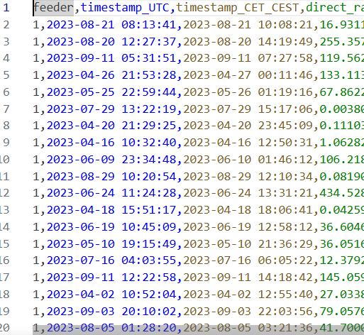
Sdv able to learn correlation trend of two columns
There is roughly a +2 hour shift between UTC and CEST.
However, it is not exact
The synthesizer tries to preserve that relationship in the synthetic data.
| Haochen Zhang | 11.05.2026

Slide 46
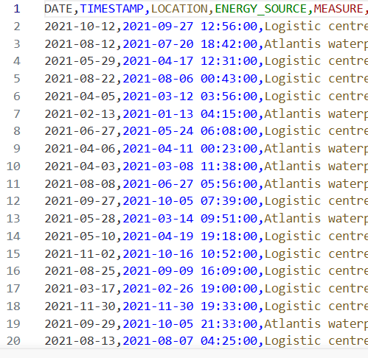
Sdv able to learn correlation trend of two columns
In this case, sdv does not learn the correlation between data and timestamp
Likely reason: the timestamp column has time.
If time is removed, sdv can generate synthetic data with same date (verified)
| Haochen Zhang | 11.05.2026

Slide 47
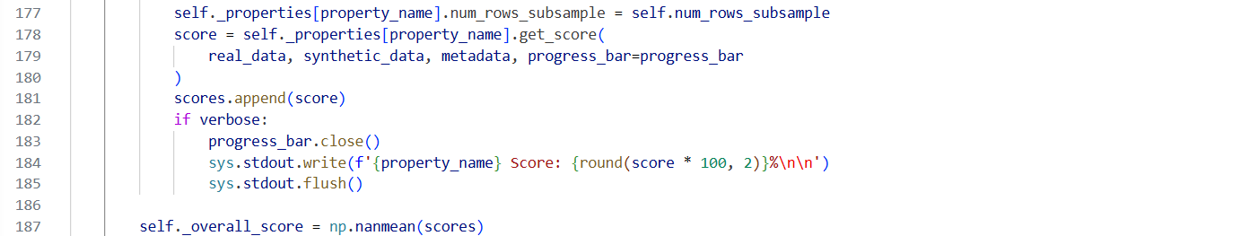
Filtered Data has higher overall score
Each property computes its own score
Some scores may be np.nan if the property cannot be computed
After all properties are evaluated, the overall score is computed as: self._overall_score = np.nanmean(scores)
Column Shapes
Column Pair Trends
*Not anonymized columns are also counted in the calculation of overall score. Example: 100% overall score with same data.
| Haochen Zhang | 11.05.2026

Slide 48
Overall Score
Column Shapes
  The statistical similarity between the real and synthetic data for single columns of data. This is often called the marginal distribution of each column.
  For each column:
    Compare real and synthetic distribution
    Compute similarity score
    Average(all column scores)
Column Pair Trends
  The statistical similarity between the real and synthetic data for pairs of columns. This is often called the correlation or bivariate distributions of the columns.
  For each column pair:
    Compare relationship in real vs synthetic data
    Compute similarity score
    Average(all pair scores)

Slide 49
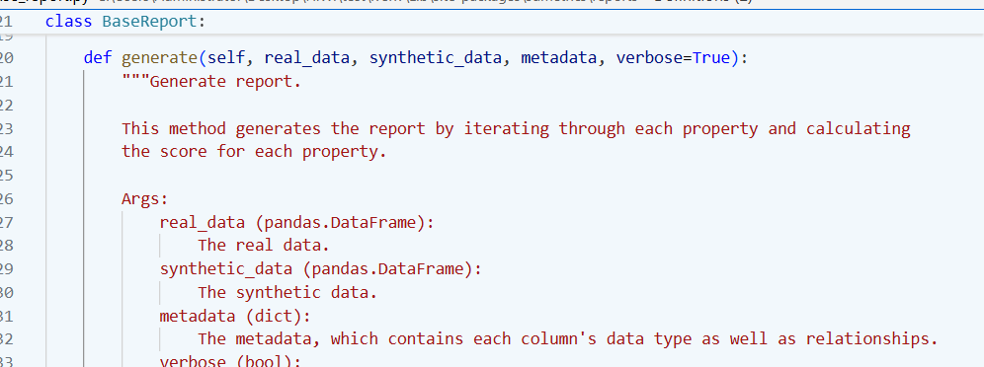
Overall score calculation

Slide 50
Related columns LLM
Related columns LLM
  SMX
    City, country and GPS
    Actor type and RBAC
    Project and service
    Username and SMXtimestamp
  Sampledata
    Date and Timestamp
    Measure, unit of measure, interval, value
  Weather data
    timestamp_UTC and timestamp_CET_CEST
    direct_radiation_W/m2 and diffuse_radiation_W/m2
    max_wind_gust_m/s, meridional_wind_m/s and zonal_wind_m/s
| Haochen Zhang | 11.05.2026

Slide 51
LLM anonymize column
| Original value | Anonymized ID | Notes |
| Atlantis waterpark | **Site_001** | Unique identifier for the waterpark site. |
| Logistic centre | **Site_002** | Unique identifier for the logistic centre. |
| Haochen Zhang | 11.05.2026

Slide 52
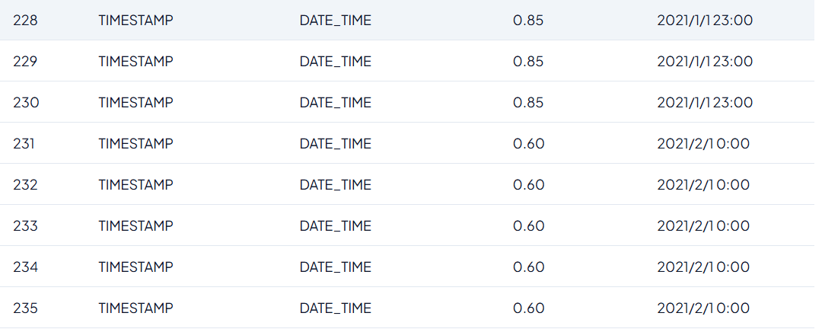
Confidence score different for same column
| Haochen Zhang | 11.05.2026

Slide 53
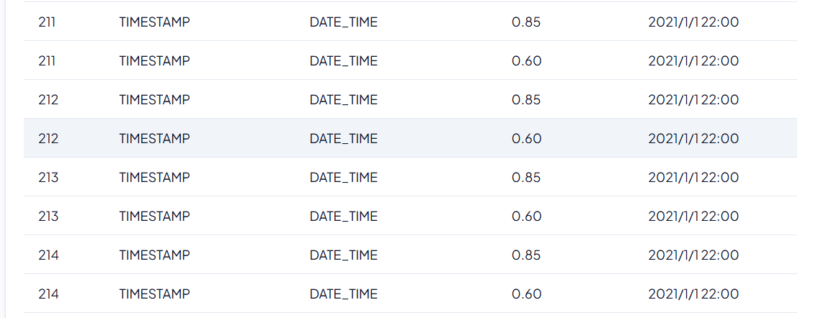
Confidence score different for same column even with same data
| Haochen Zhang | 11.05.2026

Slide 54
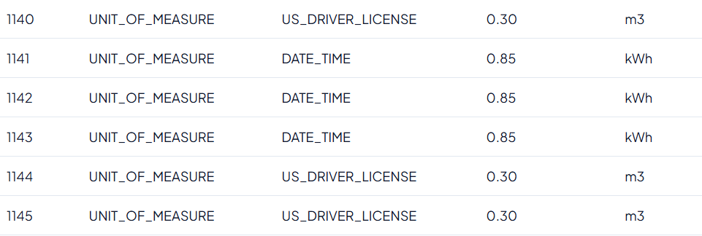
Data type false detected
| Haochen Zhang | 11.05.2026

Slide 55
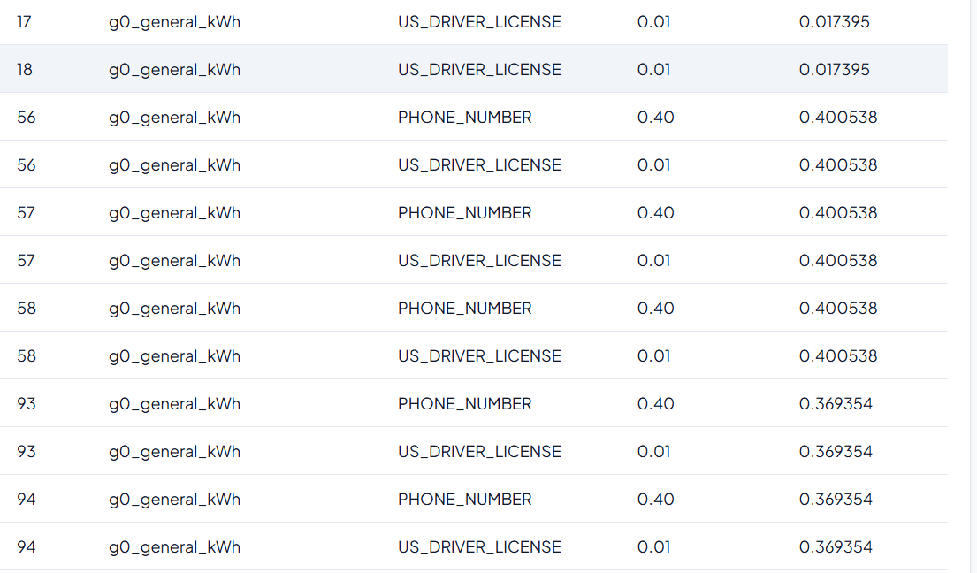
Data type false detected
| Haochen Zhang | 11.05.2026

Slide 56
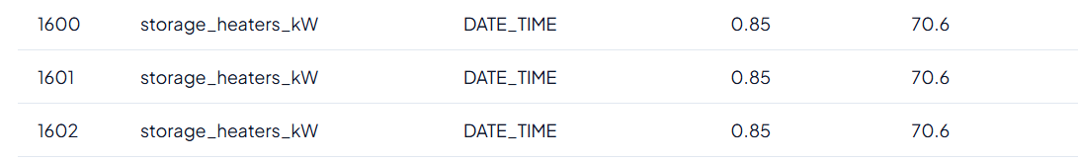
Data type false detected

Slide 57
Date preprocessing
Missing Value
Relationship between columns​

Slide 58
GridFM-Datakit
This section records the errors and bug i met, during the test of GridFM. And how to solve them

Slide 59
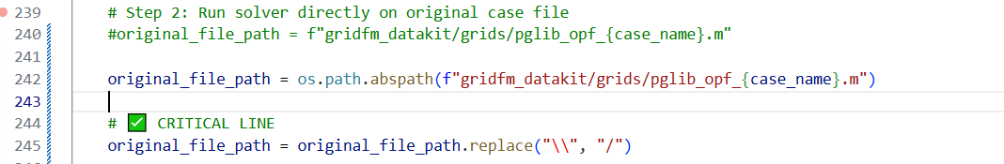
Errors
Models.parse_file("C:\Users\..."): invalid unicode escape \U
Julia cannot handle:"C:\Users\..."
  \U is interpreted as a Unicode escape
Replaced \\ with / in network.py, process_network.py and solvers.py
Function fix_path(p) added in init_julia in process_network.py

Slide 60
Errors
ERROR: ArgumentError: Package PowerModels not found in current path.
Fixed by installing PowerModels in virtuell environment

Slide 61
Errors
ERROR: UndefVarError: `Models` not defined in `Main`
  Caused by Models.parse_file(...) in network.py
Fixed to PowerModels.parse_file(...)

Slide 62
Input data for GridFM-Datakit
Imported from standard formats:
  MATPOWER (.m files)
Input data:
  Bus data
  Generator Data
  Branch Data

Slide 63
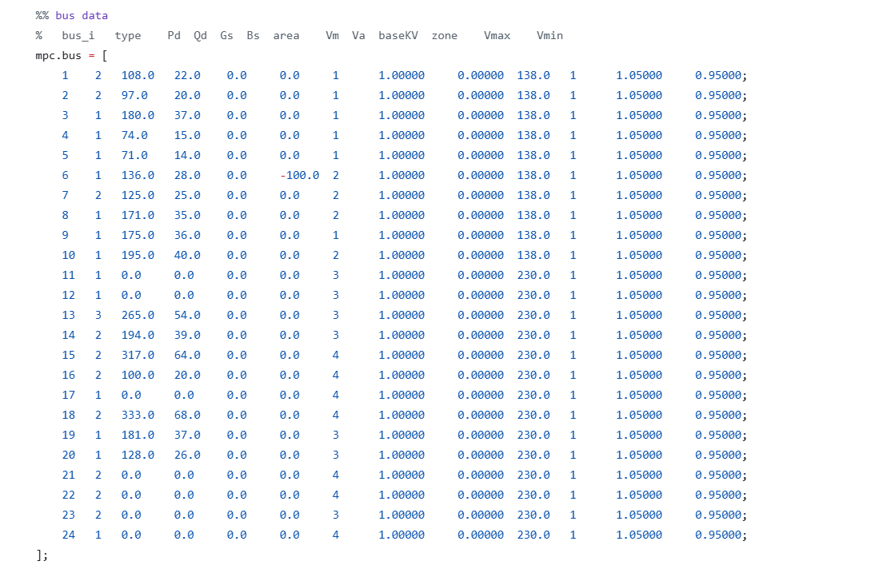
Bus data

Slide 64
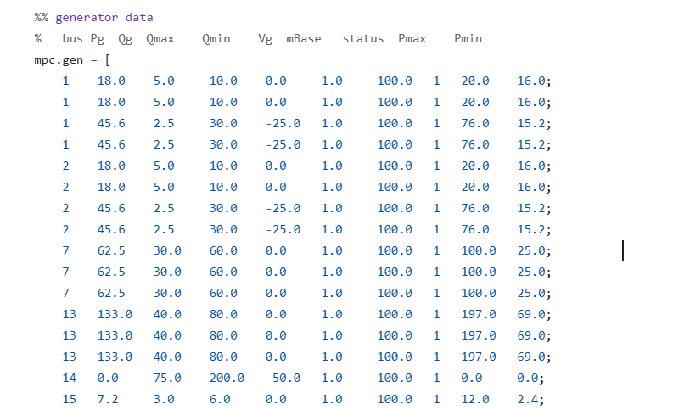
Generator Data

Slide 65
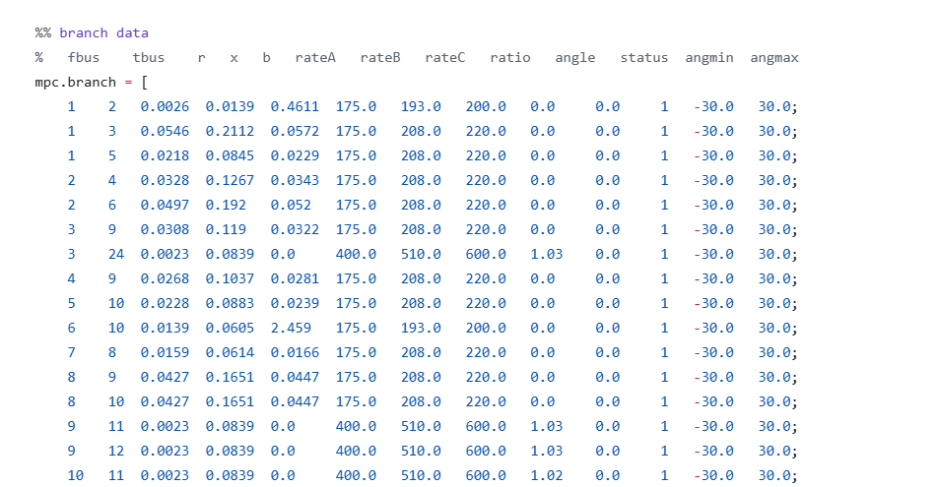
Branch Data

Slide 66
Ontology
pd.ttl → the main vocabulary/knowledge model.
pd-owl.ttl → an OWL ontology version of the same vocabulary.
Why do we need both?
  .ttl is mainly for defining concepts and relationships in a human- and machine-readable vocabulary.
  Owl.ttl expresses the same concepts as formal OWL classes.
skos:Concept means it is treated as a concept in a taxonomy.
Uses SKOS relations such as:
skos:broader pd:Language ;
  skos:inScheme pd:extended-classes ;

Slide 67
Ontology
.ttl:
  Categorization
  browsing hierarchies
  Metadata vocabularies
  Documentation
Owl.ttl
  Ontology reasoning
  Semantic validation
  Description Logic reasoning

Slide 68
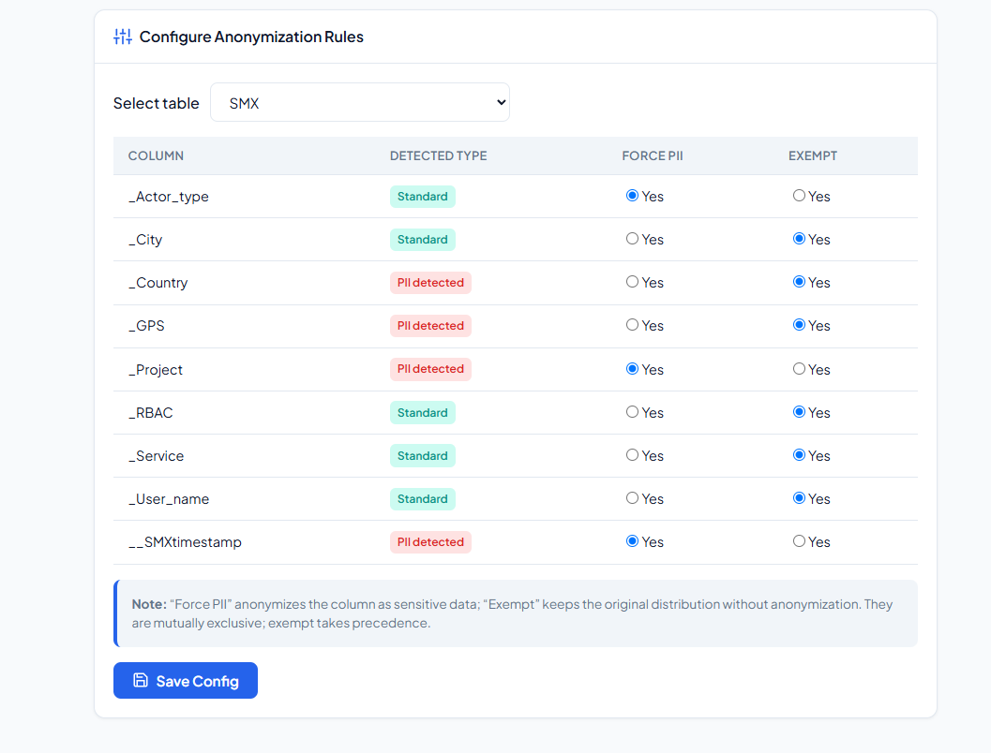
DAS 17.07

Slide 69
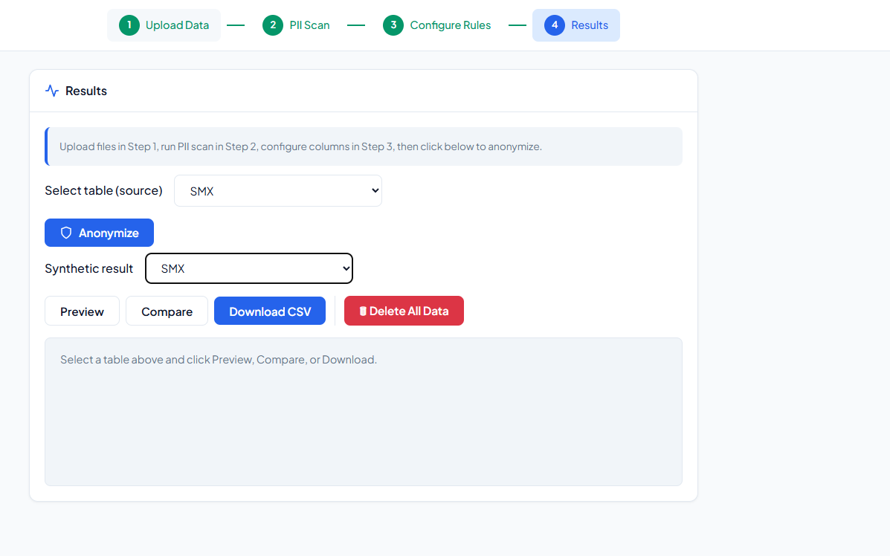
DAS 17.07

Slide 70
OWL
Object properties
  Relationships between two individuals
Datatype properties
  Describe relationships between individuals and data values
Annotation properties
  Can be used to add information to classes, individuals and object/datatype properties

Slide 71
Ontology
Similarity
0.90 - 1.00 Very similar / almost identical meaning
0.80 - 0.90 Strong match
0.70 - 0.80 Good match
0.60 - 0.70 Related
0.50 - 0.60 Weakly related
0.00 - 0.50 Usually not a useful match

Slide 72
BERT_Matching
Replacement:
Replaced from STEM.app.Matcher.Corpus_based_methods.wordembedding import bert_Energy_tsdae with
from wordembedding import bert_Energy_tsdae
Replaced #def __init__(self, model_name='.\Models\Bert base uncased_energybert'): with
def __init__(self, model_name=r"C:\Users\yga-hzh\Downloads\ENERGYBert"):
Replaced #encoded_dict = self.tokenizer.encode_plus( with
encoded_dict = self.tokenizer(

Slide 73
BERT_Matching
def class_matching(onto1, onto2):
onto1_classes = onto1.get_classes()
onto2_classes = onto2.get_classes()
onto1_lst, onto2_lst, sim_lst = bert_matching(
onto1_classes,
onto2_classes
)
output_file = (
f'Ontology Matching/Results/'
f'Matching_Results_{onto1.name}_and_{onto2.name}.csv'
)
with open(output_file, "a", encoding="utf-8") as f:
f.write("Classes\n")
df = pd.DataFrame({
onto1.name: onto1_lst,
onto2.name: onto2_lst,
"BERT_Sim": sim_lst
})
df.to_csv(
output_file,
mode="a",
index=False
)

Slide 74
BERT_Matching
def data_property_matching(onto1, onto2):
onto1_data_properties = onto1.get_data_properties()
onto2_data_properties = onto2.get_data_properties()
print(f'data_properties of {onto1.name}', onto1_data_properties)
print(f'data_properties of {onto2.name}', onto2_data_properties)
onto1_lst, onto2_lst, sim_lst = bert_matching(onto1_data_properties, onto2_data_properties)
output_file = (
f'Ontology Matching/Results/'
f'Matching_Results_{onto1.name}_and_{onto2.name}.csv'
)
with open(output_file, "a", encoding="utf-8") as f:
f.write("\nData Properties\n")
df = pd.DataFrame({
onto1.name: onto1_lst,
onto2.name: onto2_lst,
"BERT_Sim": sim_lst
})
df.to_csv(
output_file,
mode="a",
index=False
)

Slide 75
BERT_Matching
def object_property_matching(onto1, onto2):
onto1_object_properties = onto1.get_object_properties()
onto2_object_properties = onto2.get_object_properties()
print(f'object_properties of {onto1.name}', onto1_object_properties)
print(f'object_properties of {onto2.name}', onto2_object_properties)
onto1_lst, onto2_lst, sim_lst = bert_matching(
onto1_object_properties,
onto2_object_properties
)
output_file = (
f'Ontology Matching/Results/'
f'Matching_Results_{onto1.name}_and_{onto2.name}.csv'
)
# Add a blank line and section title
with open(output_file, 'a', encoding='utf-8') as f:
f.write('\nObject Properties\n')
df = pd.DataFrame({onto1.name: onto1_lst, onto2.name: onto2_lst, 'BERT_Sim': sim_lst})
df.to_csv(output_file, mode='a', index=False)

Slide 76
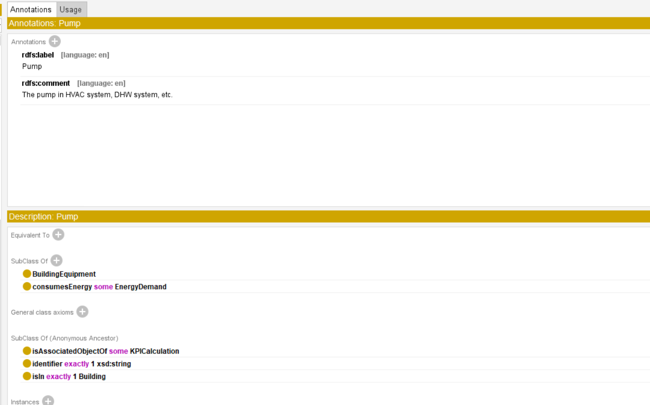
Classes with same name

Slide 77
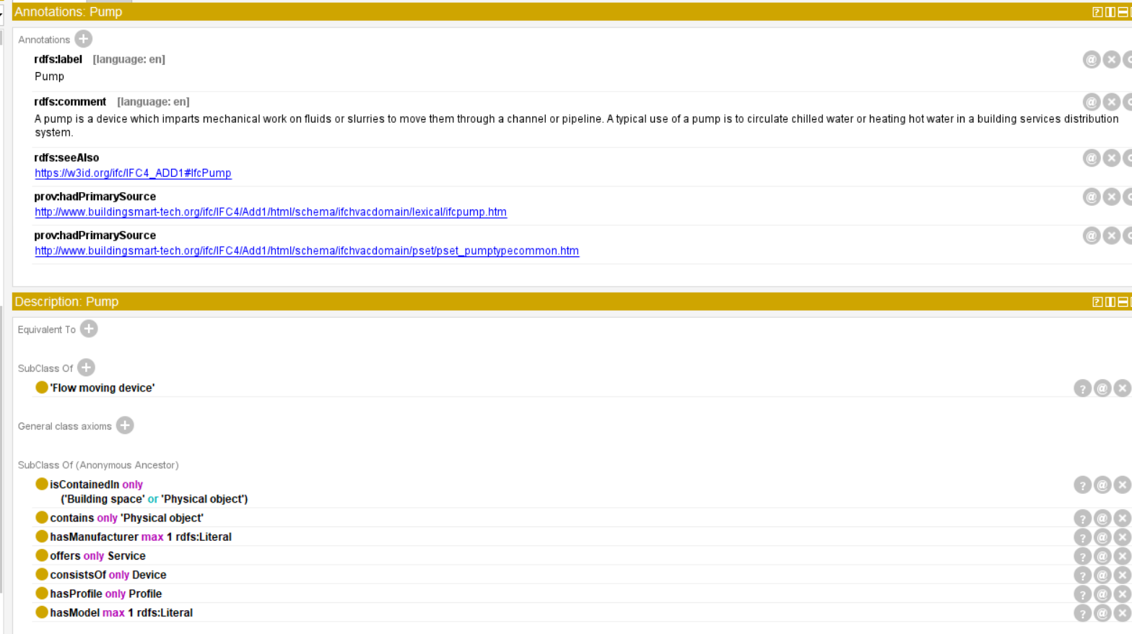
Classes with same name

Slide 78
Class?
len(beo_classes) = 617

Slide 79
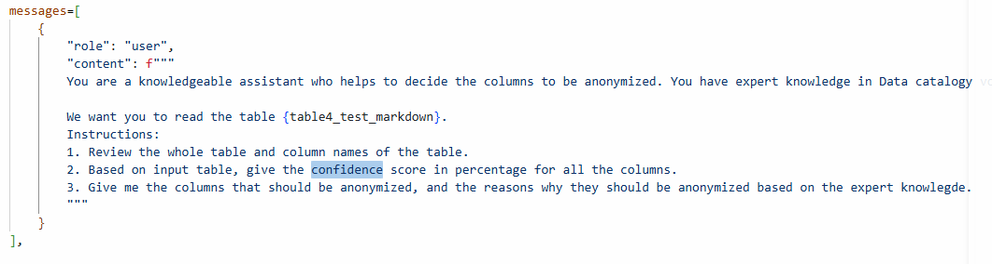
Step1: compare the results of LLM, PII(SDV) and manually
Step2: we tested different modes (which LLM models) of LLM and the realibility of LLM with multiple tests. Times: 15
LLM compared with PII and human: accuracy F1, recall and precision

Slide 80
Ontology
DPV not specific for energy domain
BEO and OEO considered (Ontology for energy domain)
Merge attempted
How to load ontology as input to LLM
All labels of properties and numbers of classes (double verify if the labels exist for all classes) (protege as benchmark)
All the code Organisation (src)
The relationship between the result from 1. step and feeding to LLM

Slide 82
Sample Title, 4th Version
Subtitle
Name of Speaker

Slide 83
Sample Title, 5th Version
Subtitle
Name of Speaker

Slide 84
Sample Title, 6th Version
Subtitle
Name of Speaker

Slide 85
Sample Title, 7th Version (logo of partner)
Subtitle
Name of Speaker

Slide 86
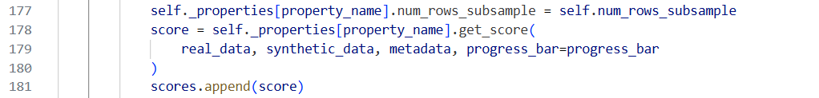
Edit the mastertitle format by clicking
Example for the use of a double-spaced title

Slide 87
Edit the mastertitle format by clicking
Example for the use of a double-spaced title
First Level
  Second Level
    Third Level
      Fourth Level
        Fifth Level
Picture title or description

Slide 88
Edit the mastertitle format by clicking
Example for the use of a double-spaced title
First Level
  Second Level
    Third Level
      Fourth Level
        Fifth Level
Picture title or description

Slide 89
Edit the mastertitle format by clicking
Example for the use of a double-spaced title
Picture title or description

Slide 90
Edit the mastertitle format by clicking
Example for the use of a double-spaced title

Slide 91
Edit the mastertitle format by clicking
Example for the use of a double-spaced title

Slide 92
Edit the mastertitle format by clicking
Example for the use of a double-spaced title

Slide 93
Edit the mastertitle format by clicking
Example for the use of a double-spaced title

Slide 94
Contact
E.ON Energy Research Center
Mathieustraße 10
52074 Aachen
Germany
FIRST NAME SURNAME
T +49 241 80 49xxx
F +49 241 80 49xxx
xxx@eonerc.rwth-aachen.de
Further Information:
http://www.eonerc.rwth-aachen.de

Slide 95
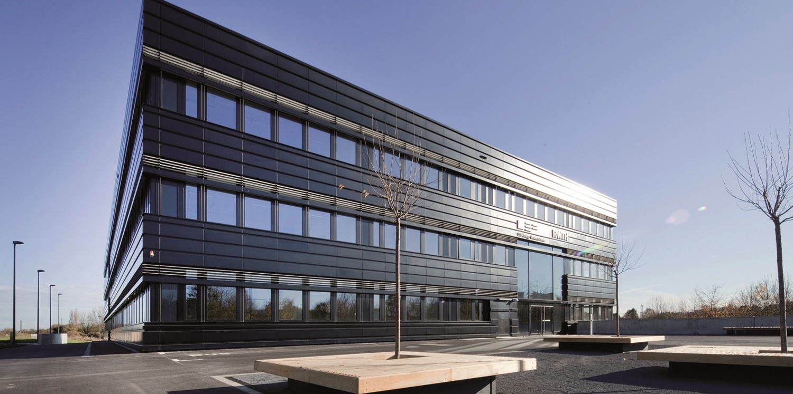
Contact
E.ON Energy Research Center
Mathieustraße 10
52074 Aachen
Germany
FIRST NAME SURNAME
T +49 241 80 49xxx
F +49 241 80 49xxx
xxx@eonerc.rwth-aachen.de
http://www.eonerc.rwth-aachen.de

Slide 96
Contact
E.ON Energy Research Center
Mathieustraße 10
52074 Aachen
Germany
FIRST NAME SURNAME
T +49 241 80 49xxx
F +49 241 80 49xxx
xxx@eonerc.rwth-aachen.de
Further Information:
http://www.eonerc.rwth-aachen.de

Slide 97
Thanks to our partner.
Thanks to our partner
Thanks to our partner
Thanks to our partner
Thanks to our partner

Slide 98
Thanks to our partner
Thanks to our partner
Thanks to our partner
Thanks to our partner
Thanks to our partner
Thanks to our partner

